Slide 1
Case 1: set PFC threshold of all switches to 40KB
r₁ = B
S1
L1
S2
Flow 1
tx
rx
rx
tx
L4
L2
r₂ = B
tx-1
L3
rx
S4
S3
Flow 2
tx-2
rx
tx
Link delay = 0.001ms, link capacity = 40Gbps
All PFC Threshold = 40 KB, Deadlock will not happen.

Slide 2
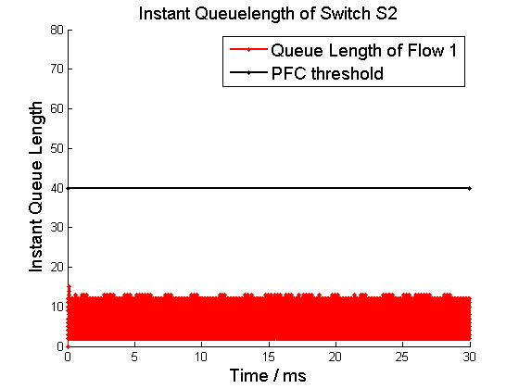
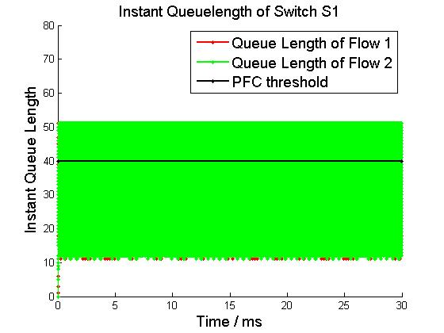
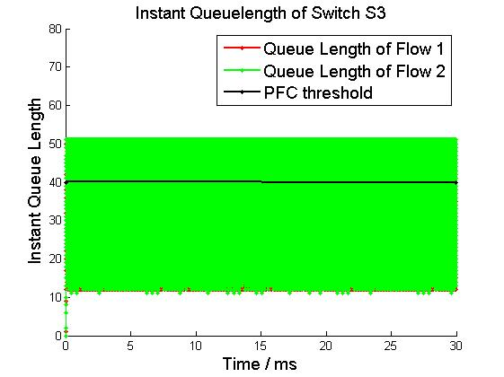
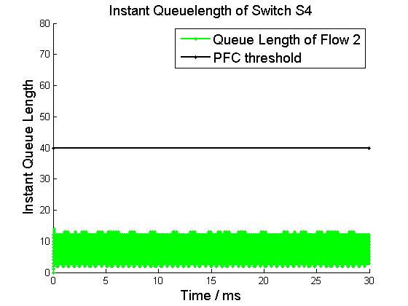
Buffer Occupation
r₁ = B
S1
L1
S2
Flow 1
tx
rx
rx
tx
L4
L2
r₂ = B
tx-1
L3
rx
S4
S3
Flow 2
tx-2
rx
tx

Slide 3
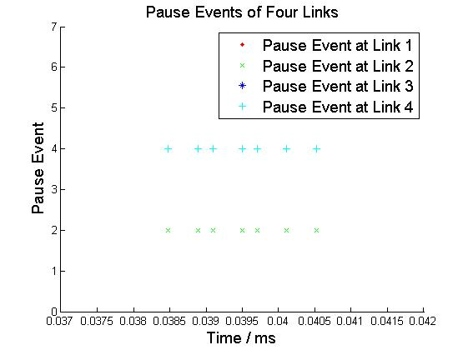
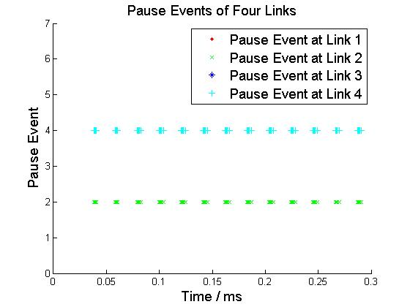
Pause Pattern
Micro View
Macro View
Pause Events only happens at L2 and L4.

Slide 4
Case 2: set PFC threshold of S2 and S4 to 1KB
r₁ = B
S1
L1
S2
Flow 1
tx
rx
PFC Threshold of RX in S4
= 1 KB
rx
tx
PFC Threshold of RX in S2
= 1 KB
L4
L2
r₂ = B
tx-1
L3
rx
S4
S3
Flow 2
tx-2
rx
tx
Link delay = 0.001ms, link capacity = 40Gbps
All Other PFC Threshold = 40 KB, Deadlock will happen.

Slide 5
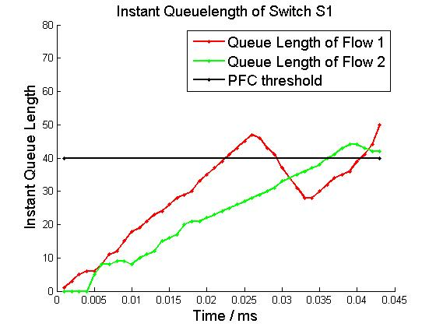
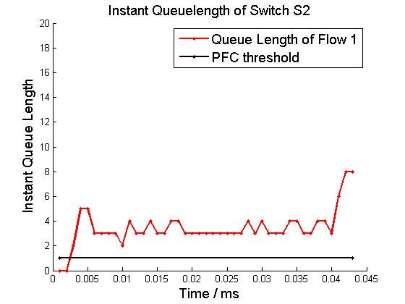
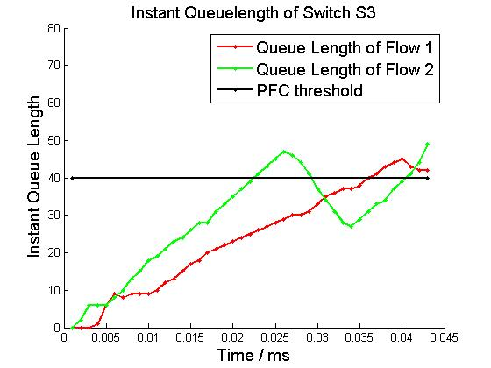
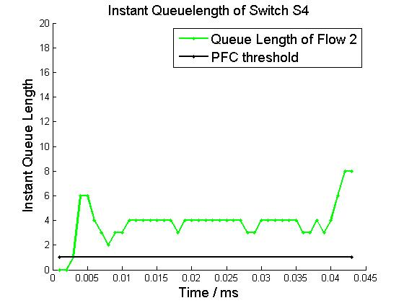
Buffer Occupation
r₁ = B
S1
L1
S2
Flow 1
tx
rx
rx
tx
L4
L2
r₂ = B
tx-1
L3
rx
S4
S3
Flow 2
tx-2
rx
tx

Slide 6
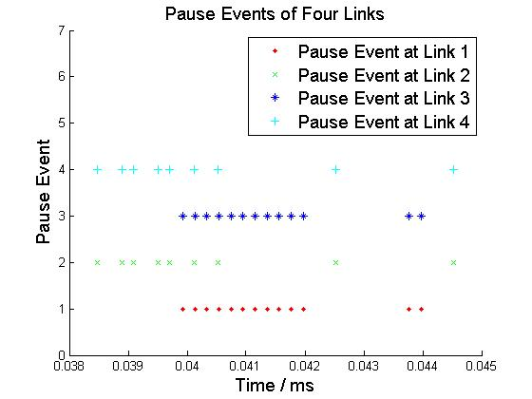
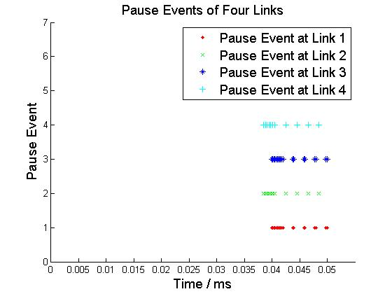
Pause Pattern
Micro View
Macro View
Deadlock occurs when four links are paused at the same time.

Slide 7
Case 3: set PFC threshold of S2 and S4 to 10KB
r₁ = B
S1
L1
S2
Flow 1
tx
rx
PFC Threshold of RX in S4
= 10 KB
rx
tx
PFC Threshold of RX in S2
= 10 KB
L4
L2
r₂ = B
tx-1
L3
rx
S4
S3
Flow 2
tx-2
rx
tx
Link delay = 0.001ms, link capacity = 40Gbps
All Other PFC Threshold = 40 KB, Deadlock will happen.

Slide 8
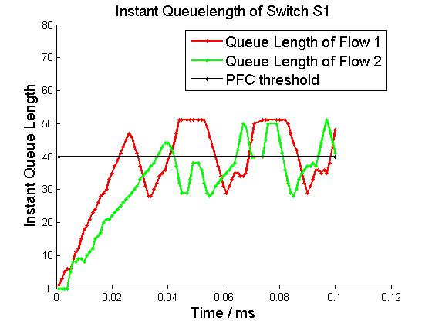
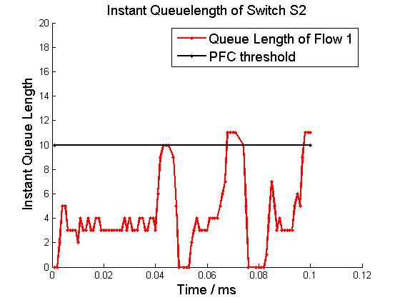
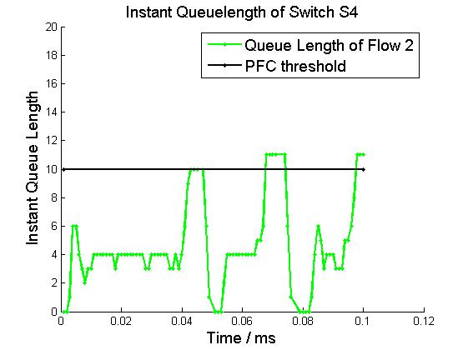
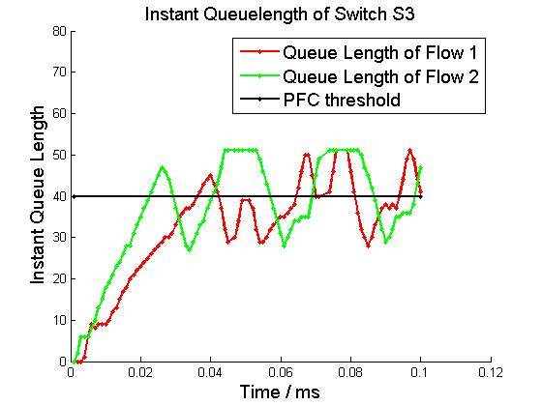
Buffer Occupation
r₁ = B
S1
L1
S2
Flow 1
tx
rx
rx
tx
L4
L2
r₂ = B
tx-1
L3
rx
S4
S3
Flow 2
tx-2
rx
tx

Slide 9
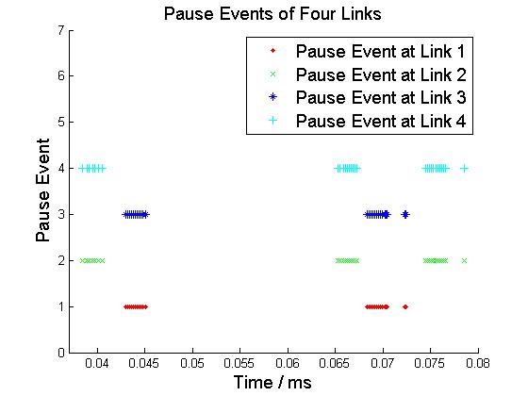
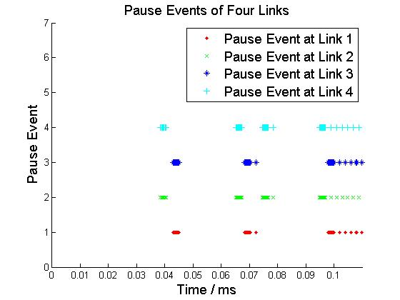
Pause Pattern
Micro View
Macro View
Deadlock occurs when four links are paused at the same time.

Slide 10
Case 4: set PFC threshold of S4 to 1KB
r₁ = B
S1
L1
S2
Flow 1
tx
rx
PFC Threshold of RX in S4
= 1 KB
rx
tx
L4
L2
r₂ = B
tx-1
L3
rx
S4
S3
Flow 2
tx-2
rx
tx
Link delay = 0.001ms, link capacity = 40Gbps
All Other PFC Threshold = 40 KB, Deadlock will happen.

Slide 11
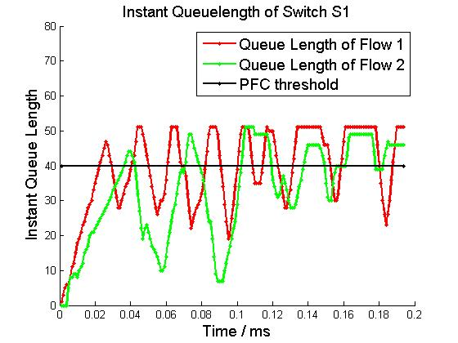
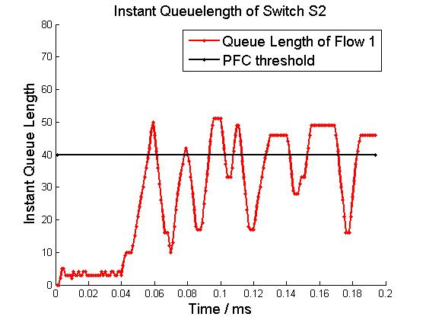
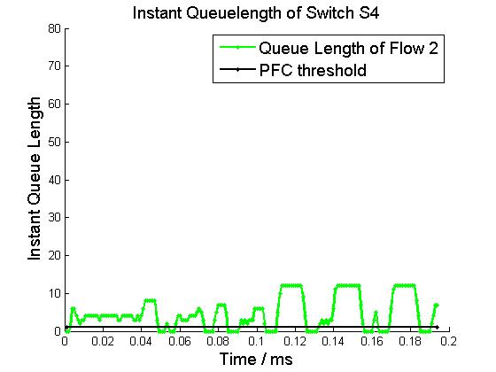
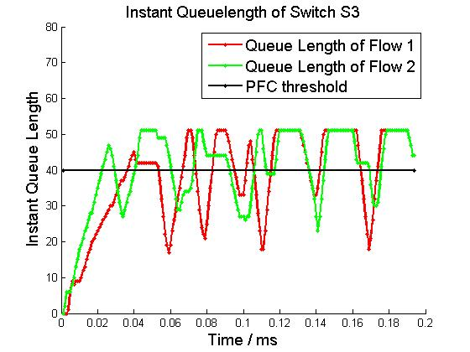
Buffer Occupation
r₁ = B
S1
L1
S2
Flow 1
tx
rx
rx
tx
L4
L2
r₂ = B
tx-1
L3
rx
S4
S3
Flow 2
tx-2
rx
tx

Slide 12
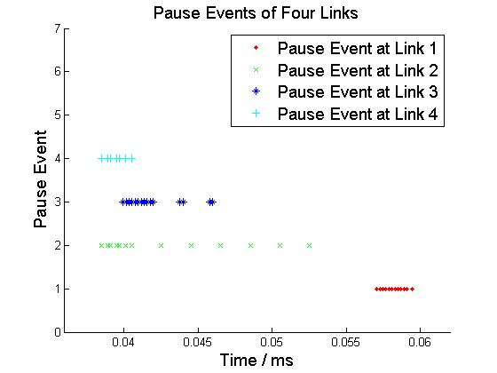
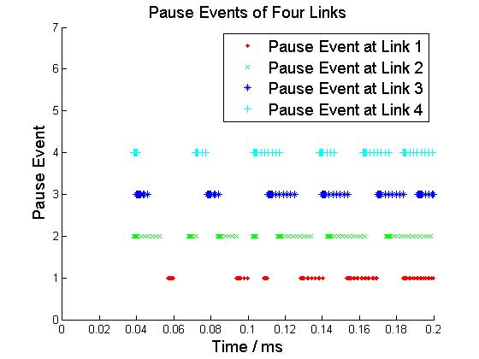
Pause Pattern
Micro View
Macro View
Deadlock occurs when four links are paused at the same time.

